Slide 1


CSE312
Daffodil International University
Database Management System Lab
Department of CSE
MediSeba
“Online Doctor Appointment, Payment & Prescription Management System”
Submitted To
Submission Date
Syed Eftasum Alam (SEA)
15 March 2026
Lecturer, Department of CSE
Group Members
Md. Emon Hossain
(TL) : 232-15-818
Mostafizur Rahman Antu
: 241-15-631
Nahid Al Galib
: 241-15-577
Mahjabin Sultana
: 241-15-899
Nadira Tanzim
: 241-15-397
01

Slide 2

PRESENTATION OVERVIEW
Table of Contents
01
Introduction
02
Problem Statement
03
Motivation & Objectives
System overview and architecture
Challenges in manual systems
Goals and driving factors
04
Feature Listing
05
ER Diagram
06
Gap Analysis
Comprehensive system features
Database entity relationships
Existing vs proposed system
07
Tools & Technologies
08
Work Distribution
09
Conclusion
Technology stack overview
Team member responsibilities
Summary and key takeaways
02

Slide 3
SYSTEM OVERVIEW
Introduction
Key Benefits
Automated token generation eliminates conflicts
What is MediSeba?
Digital prescription storage for easy access
MediSeba is a database-driven healthcare management system designed to streamline the entire patient journey from appointment booking to prescription management. The system enables patients to book doctor appointments online, receive automatic token numbers, complete digital payments, and store prescriptions for future reference.
Secure payment tracking with transaction IDs
Centralized patient medical history
Core Modules
Multi-Role Architecture
The system supports three distinct user roles with role-based access control, ensuring secure and efficient management of healthcare operations:
Appointment Booking
Payment Management
Prescription System
Admin
Doctor
Patient
User Management
System Management
Medical Services
Healthcare Access
03

Slide 4
IDENTIFYING CHALLENGES
Problem Statement
Current System Limitations
Impact Analysis
Many hospitals and clinics still rely on manual appointment and token management systems, which create significant operational challenges and negatively impact patient experience.
Operational Efficiency
-40%
Patient Satisfaction
-35%
Serial Conflicts
Payment Tracking Issues
Data Accuracy
-50%
Multiple patients assigned same token numbers causing confusion and delays
Difficulty tracking payment status (pending/success/failed/refunded)
Lost Prescriptions
No Patient History
Key Issues Summary
Paper prescriptions easily lost or damaged, not accessible for future visits
Patient medical details not stored systematically, making diagnosis difficult
1
Manual systems are slow and prone to human errors
2
No centralized database for patient information
The Solution
A structured database-based system is required to manage appointments, payments, and prescriptions accurately and efficiently, ensuring data integrity and improving healthcare service quality.
3
Difficulty in managing doctor schedules efficiently
4
Lack of audit trail for payments and appointments
04

Slide 5
PROJECT FOUNDATION
Motivation & Objectives
Motivation
Objectives
Need for Speed
Healthcare systems require faster and more reliable appointment management to handle increasing patient volumes efficiently.
Online Booking
Schedule Management
Create an efficient online appointment booking system
Maintain doctor schedules efficiently with real-time updates
Error Reduction
Manual systems are slow and prone to errors, leading to patient dissatisfaction and operational inefficiencies that can be life-threatening in healthcare settings.
Payment Tracking
Digital Prescriptions
Track payments with unique transaction IDs
Store prescriptions digitally for easy access
Data Security
Patient medical records require secure, centralized storage with proper access controls to protect sensitive health information.
Secure Medical Records
Maintain patient medical records securely with proper data integrity and access controls
05

Slide 6
SYSTEM CAPABILITIES
Feature Listing
User Management
Doctor Management
Patient Management
User registration and login
Doctor profile management
Personal details management
OTP verification system
Specialization & consultation fee
Health information storage
Role-based access control
Weekly schedule management
Emergency contacts
Appointment System
Payment System
Prescription System
Online booking system
Transaction ID tracking
Symptoms & diagnosis
Automatic token number
Payment status tracking
Medicines & dosage
Status tracking
Refund management
Medical advice & follow-up
06

Slide 7

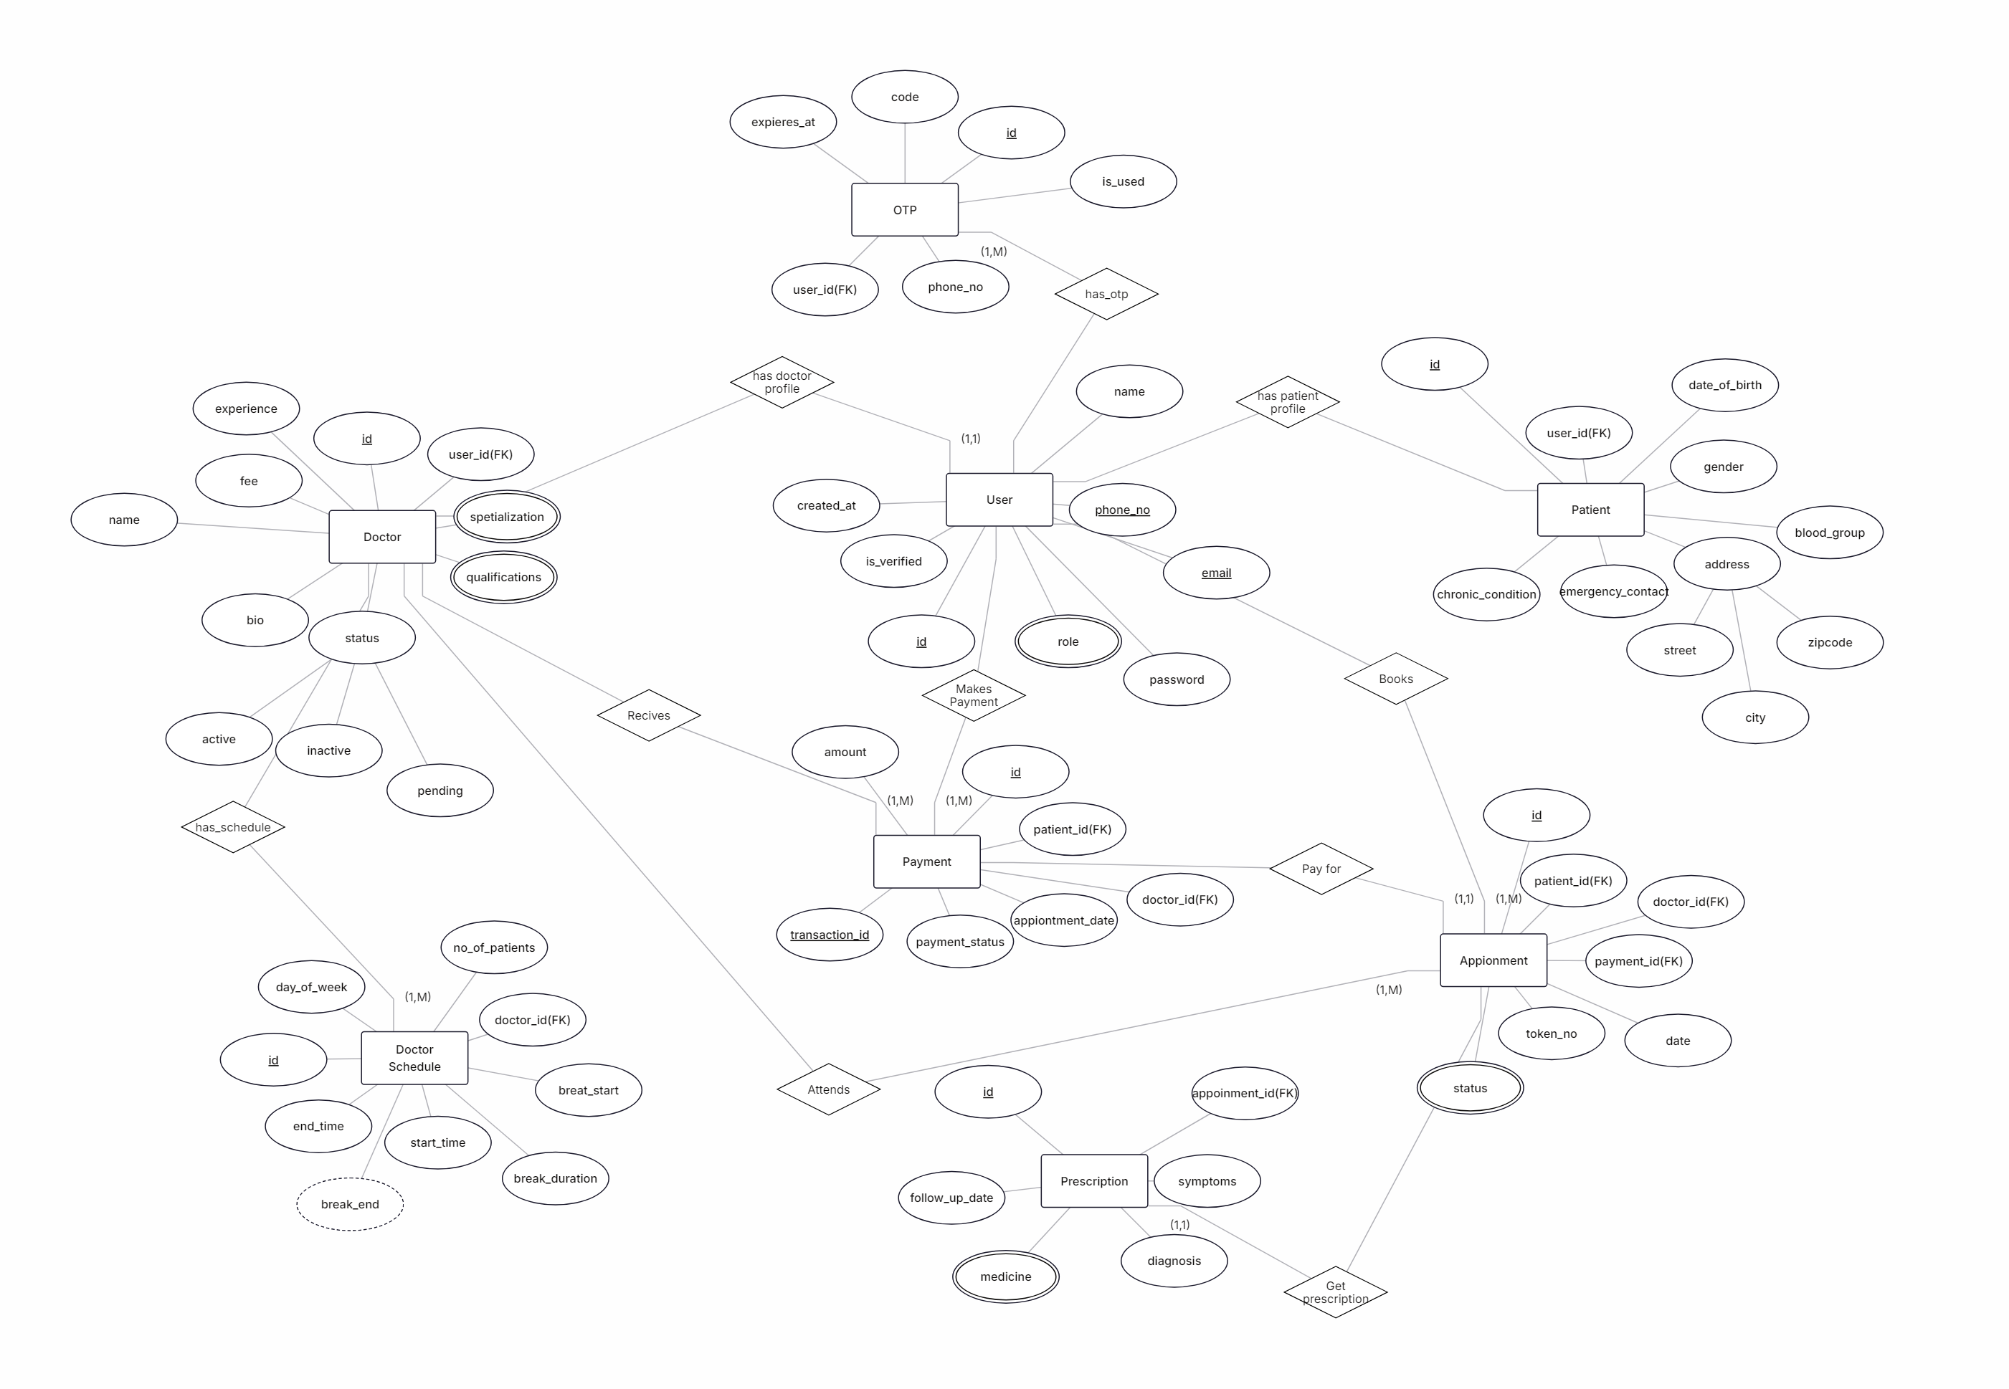
DATABASE DESIGN
Entity-Relationship Diagram
ER Diagram Structure
Key Relationships
Patient → Appointment
Books appointments with automatic token generation
Doctor → Schedule
Manages weekly schedules and availability
Appointment → Payment
Generates payment records with transaction IDs
Appointment → Prescription
Creates digital prescriptions linked to visits
07

Slide 8
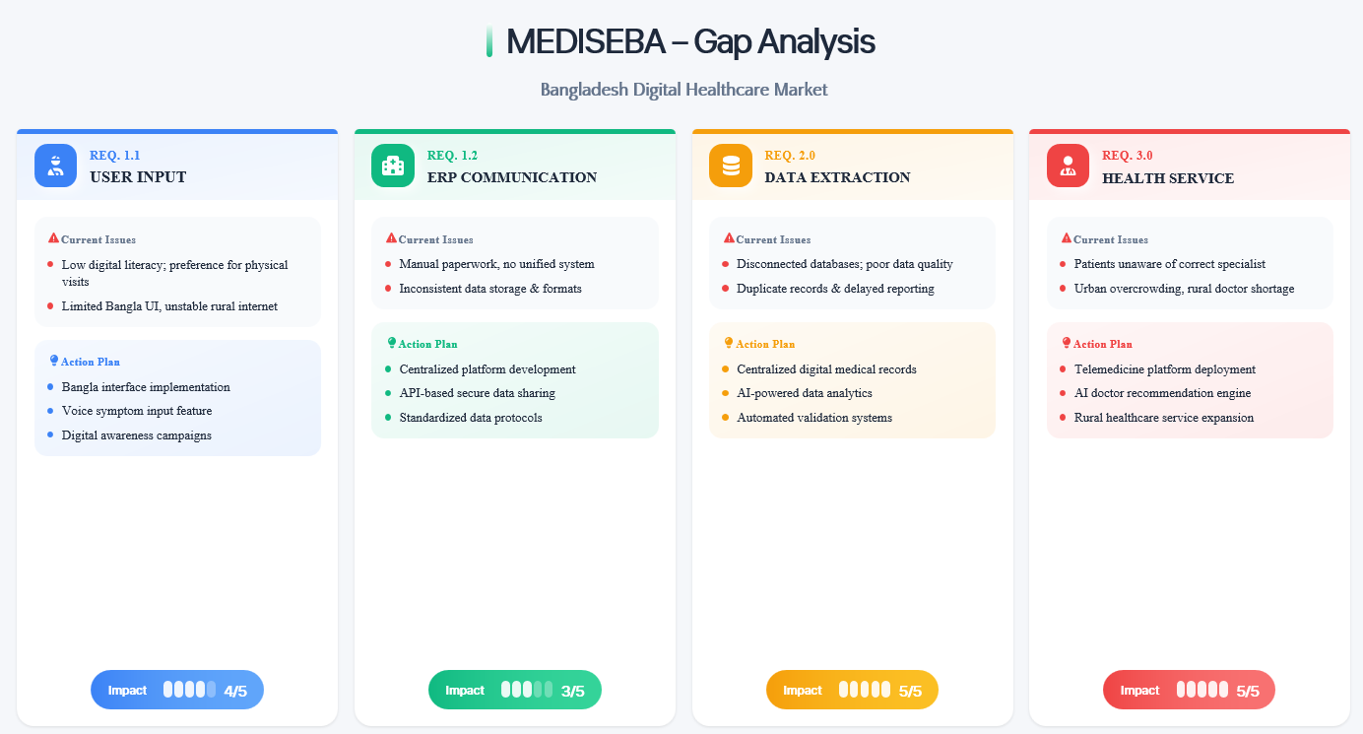
Efficiency Loss
Patient Complaints
Expected Improvement
-45%
+60%
+85%
Manual systems reduce operational efficiency
Higher dissatisfaction with manual processes
Efficiency gain with digital system
08

Slide 9
TECHNOLOGY STACK
Tools & Technologies
Frontend
Database
HTML5
MySQL
Web page structure and content
Relational database system for structured data storage
CSS3
Design, layout, and responsiveness
Server
JavaScript
Form validation and dynamic interactions
XAMPP
Local server environment (Apache + MySQL + PHP)
Backend
Database Management
PHP
Server-side logic, role-based access, appointment and payment processing
phpMyAdmin
Database management and query execution tool
09

Slide 10





TEAM COLLABORATION
Work Distribution
Team Member Responsibilities
Workload Distribution
Database Design
20%
Md. Emon Hossain
Team Leader • 232-15-818
Backend Development
25%
Backend Development
Frontend Development
Database Design
Documentation
Frontend Development
25%
MA
Mostafizur Rahman Antu
Documentation
15%
241-15-631
Backend Development
Frontend Development
Database Design
Testing & Data Entry
15%
NG
Nahid Al Galib
Team Strengths
241-15-577
Testing & Data Entry
Backend Development
Balanced skill distribution
Clear role definitions
MS
Mahjabin Sultana
NT
Nadira Tanzim
241-15-899
241-15-397
Comprehensive coverage
Testing & Data Entry
Backend Development
Testing & Data Entry
Backend Development
Efficient collaboration
10

Slide 11

Conclusion
MediSeba provides a complete digital healthcare management system that transforms traditional manual processes into an efficient, organized, and secure database-driven solution.
Reduced Conflicts
Better Service
Automated token system eliminates appointment scheduling conflicts
Improved patient experience through streamlined processes
Secure Storage
Payment Tracking
Medical records stored securely with proper access controls
Efficient payment management with transaction ID tracking
Project Status
Ready for Implementation
MediSeba Project
11
CSE312 – Database Management System Lab

